Slide 1

RAKUTEN PROJECT PHASE - 2
EdgeBee: Swarm Intelligence meets Generative AI
on Edge Devices
Chethana R Kini – 4NM21AI018
Manya Hegde – 4NM21AI038
Reyona Elza Sabu – 4NM21AI059

Slide 2
Introduction
The project aims at generating content on edge devices using evolutionary algorithms for optimization.
The pruning technique is applied to reduce the size of the model for easy deployment.
Overfitting is avoided by saving weights.
The saved weights are further optimized using various evolutionary algorithms.

Slide 3
Introduction (Cont’d)
Optimization of LLMS
Genetic Algorithm (GA)
Inspired by natural evolution, uses selection, crossover, and mutation.
Fitness function determines the best candidates for the next generation.
BAT algorithm
Inspired by bats' echolocation behavior.
Adjusts frequency and loudness to explore and exploit solutions.
Particle Swarm Optimization (PSO)
Modeled on the social behavior of birds or fish swarming.
Particles move through the search space, adjusting based on individual and group experiences.

Slide 4
Problem Statement
Design and development of optimized LLM’s using Evolutionary Algorithms on Edge Devices.
Objectives
1. To optimize LLM models using various evolutionary algorithms.
2. To aggregate across multiple federated learning client devices.
3. To build a personalized system to generate content using GenAI.

Slide 5
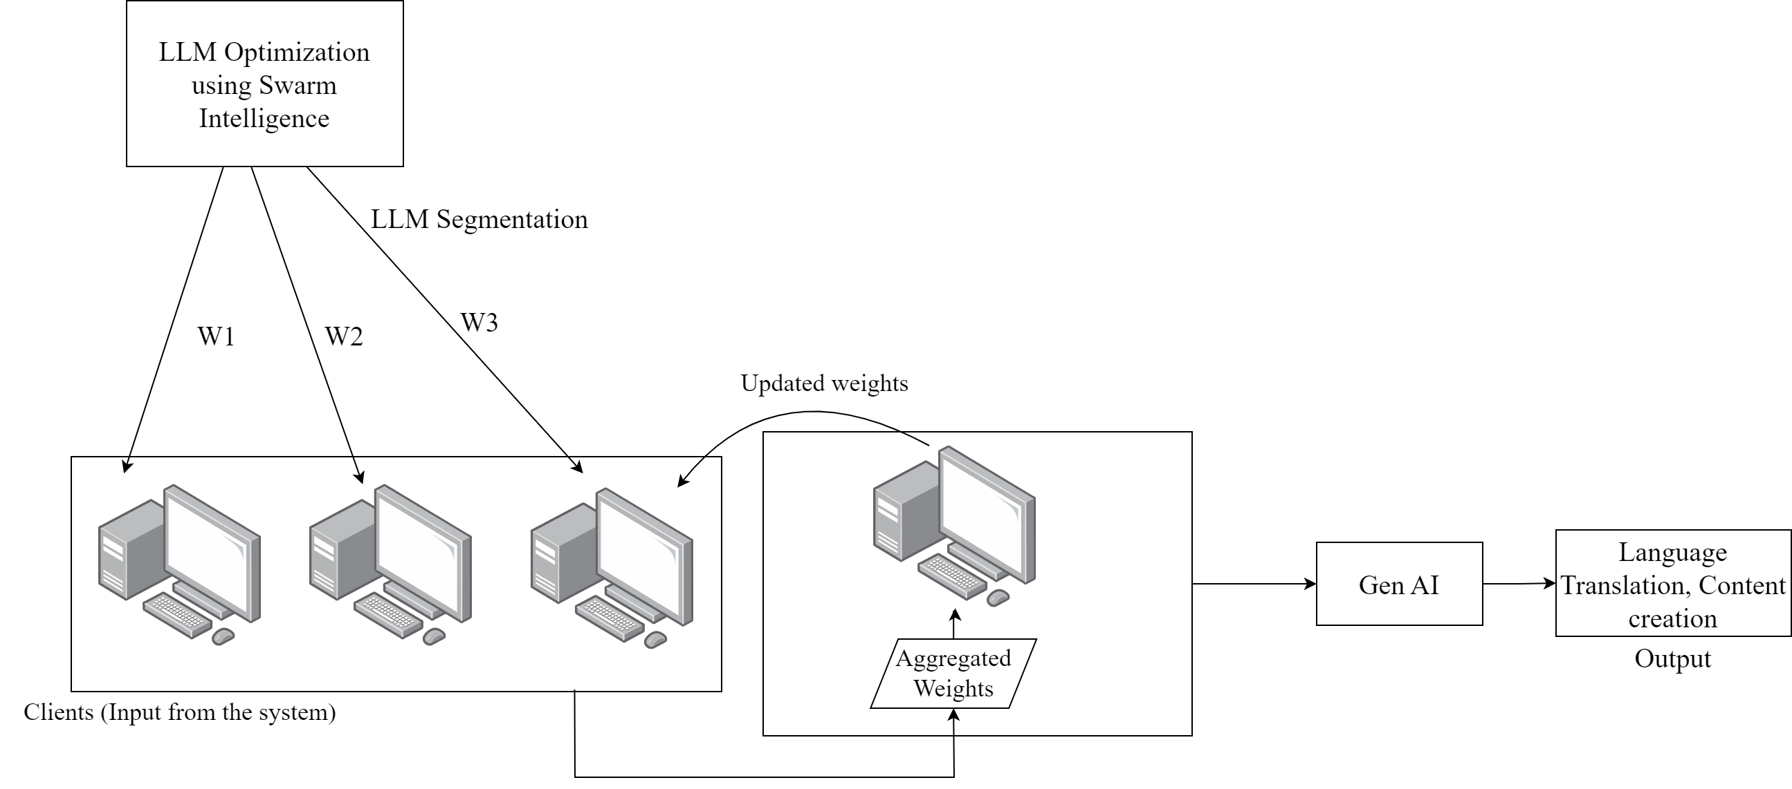
Proposed Methodology

Slide 6
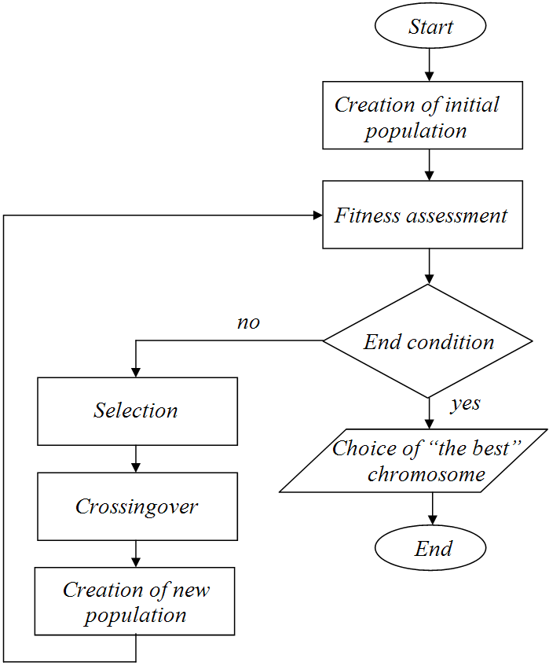
Implementation Details
Optimization
Genetic Algorithm
On Iris dataset,
Model | Dataset | Accuracy
ANN | IMDB | 56%
CNN | IMDB | 51%
Albert | IMDB | 87%
Model | Fitness Function | Accuracy
ANN | CCE | 63%
ANN | MSE | 93%
ANN | Hybrid | 89%
CNN | Hybrid | 73%

Slide 7
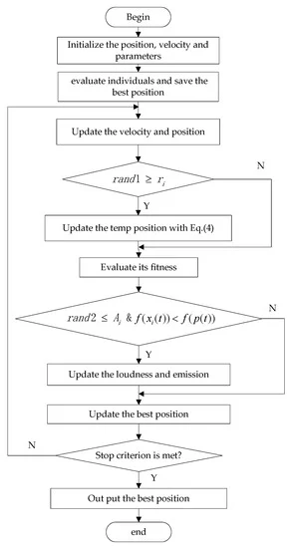
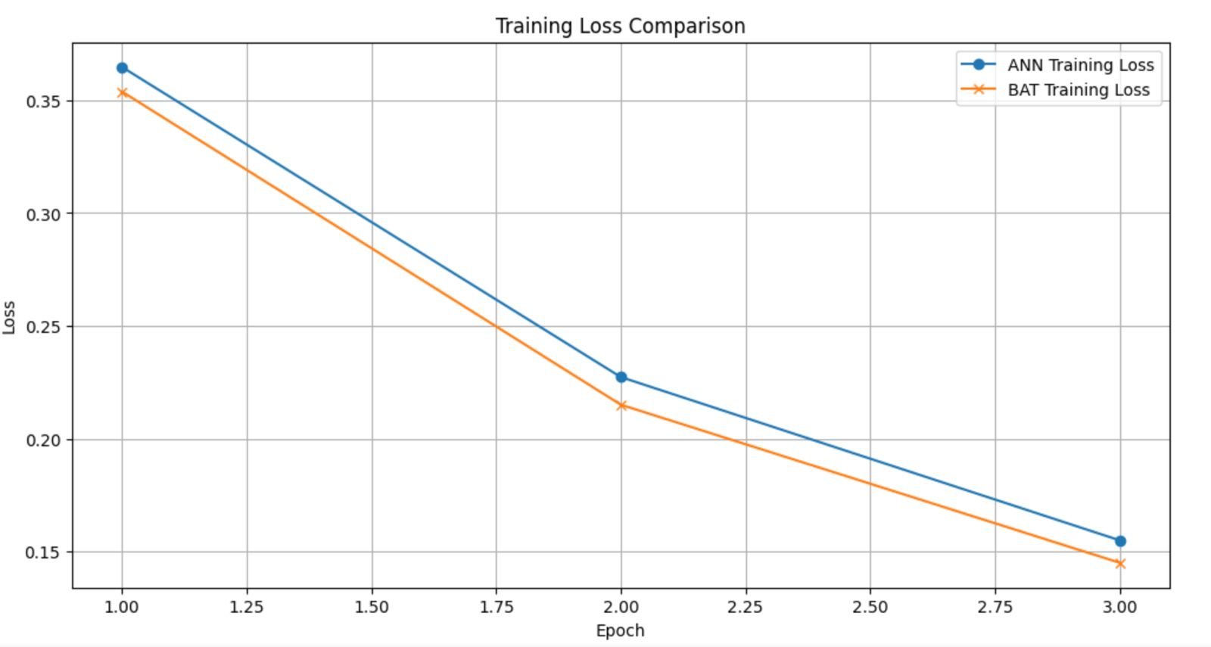
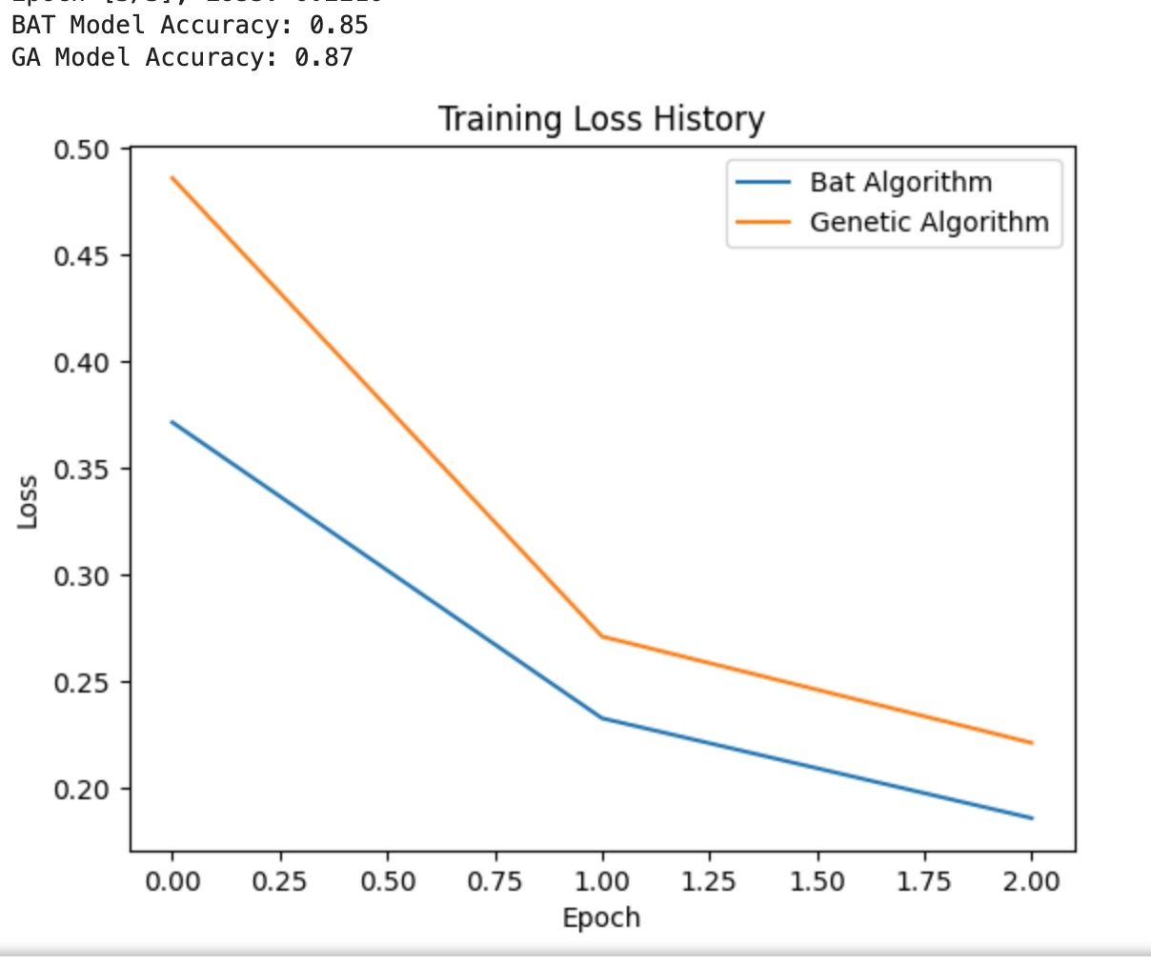
ii. Bat Algorithm
Model | Dataset | Accuracy
ANN | IMDB | 85%

Slide 8
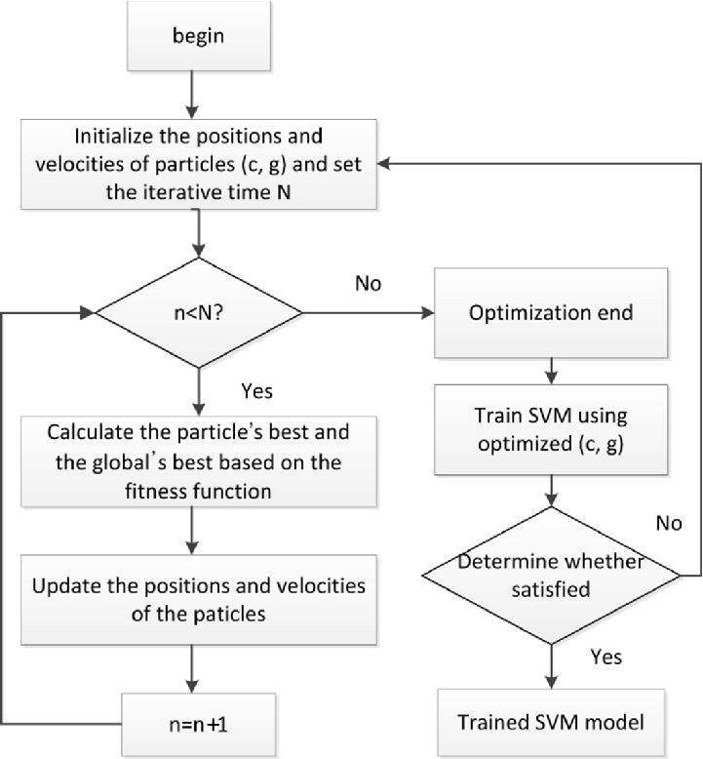
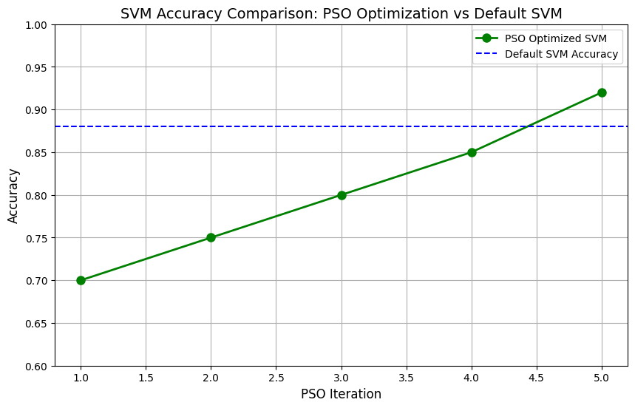
iii. Particle Swarm Optimization
Model | Dataset | Accuracy
SVM | IMDB | 88.7%
ANN | IMDB | 87.49%
CNN | IMDB | 74%
TinyBert | IMDB | 69.5%

Slide 9
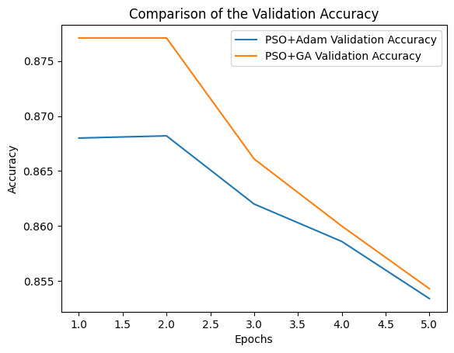
iv. Hybrid Optimization
PSO + Adam
PSO + GA
Model | Dataset | Accuracy
ANN | IMDB | 85.34%
Model | Dataset | Accuracy
ANN | IMDB | 85.42%

Slide 10
2. Pruning
TinyBERT model trained on the IMDb dataset for binary sentiment classification.
L1 pruning removes weights close to zero, simplifying the model by eliminating redundant parameters.
Pruning makes the model more efficient by shrinking unnecessary weights, resulting in a faster, smaller model.
The L1 regularization encourages sparsity by pushing weights toward zero, effectively removing less important connections.
Model | Dataset | Pruning method | Optimization Techniques | Accuracy
ANN | IMDB | L1 Pruning | GA | 50%
ANN | IMDB | L1 Pruning | BA | 86%
TinyBERT | IMDB | L1 Pruning | PSO | 85.94%

Slide 11
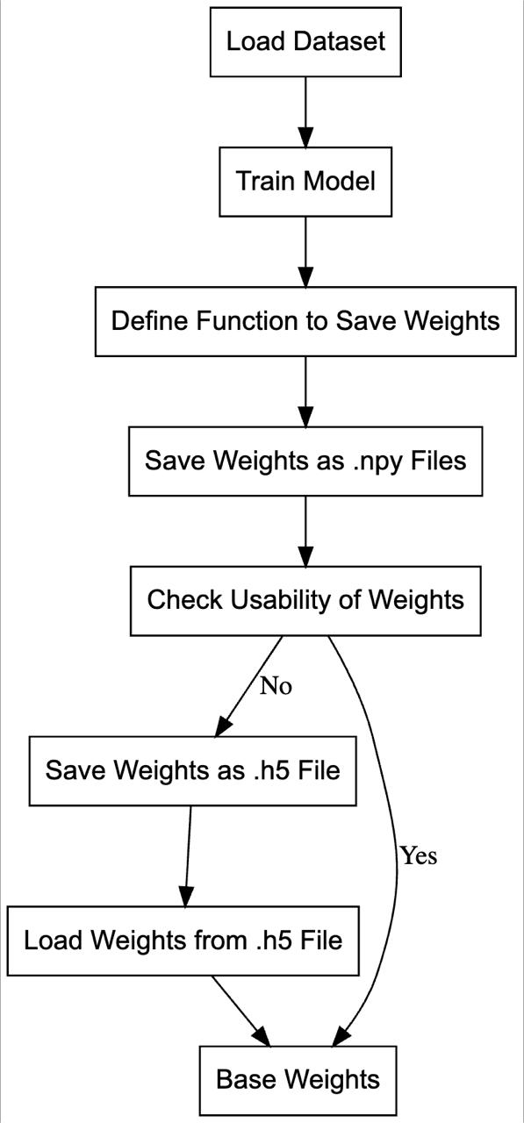
3. Saving Weights
Purpose of Saving Weights
Utilization in Optimization
Distribution to Clients
Enhancing Model Performance

Slide 12
Experimental Results
Algorithms | Best Model | Best Accuracy
Genetic Algorithm | Albert | 87%
Bat Algorithm | ANN with L1 pruning | 86%
Particle Swarm Optimization | SVM | 88.7%
Hybrid of PSO and GA | ANN | 85.42%

Slide 13
Challenges faced
Convergence Speed: Many optimization algorithms may have slow convergence, requiring more iterations to find the optimal solution.
Parameter Tuning: The performance of these algorithms is highly sensitive to the choice of parameters, making it challenging to find the optimal settings.
Computational Cost: The algorithms can become computationally expensive, especially for large-scale problems, due to repeated evaluations of solutions.

Slide 14
Conclusion
Various evolutionary algorithms were implemented, the bat and PSO performance was better.
The hybrid optimization technique gave an efficient results, which can be further improved by fine-tuning, pruning and quantization techniques.
Future work would be to further improve using various hybrid models.
Work on distribution of models with different approaches

Slide 15
Plan of work
Milestones | Month | Status
Literature Survey | July | Ongoing
Exploring various Evolutionary Algorithms | August | Completed
Implementation of Algorithms | August | Completed
Pruning | September | Ongoing
Implementation of Hybrid Algorithms | September | Ongoing
Distribution of Models | October | Future Work

